Slide 1
Fluvial Geomorphology: Basic Channel Ratios
Zach HIlgendorf

Slide 2
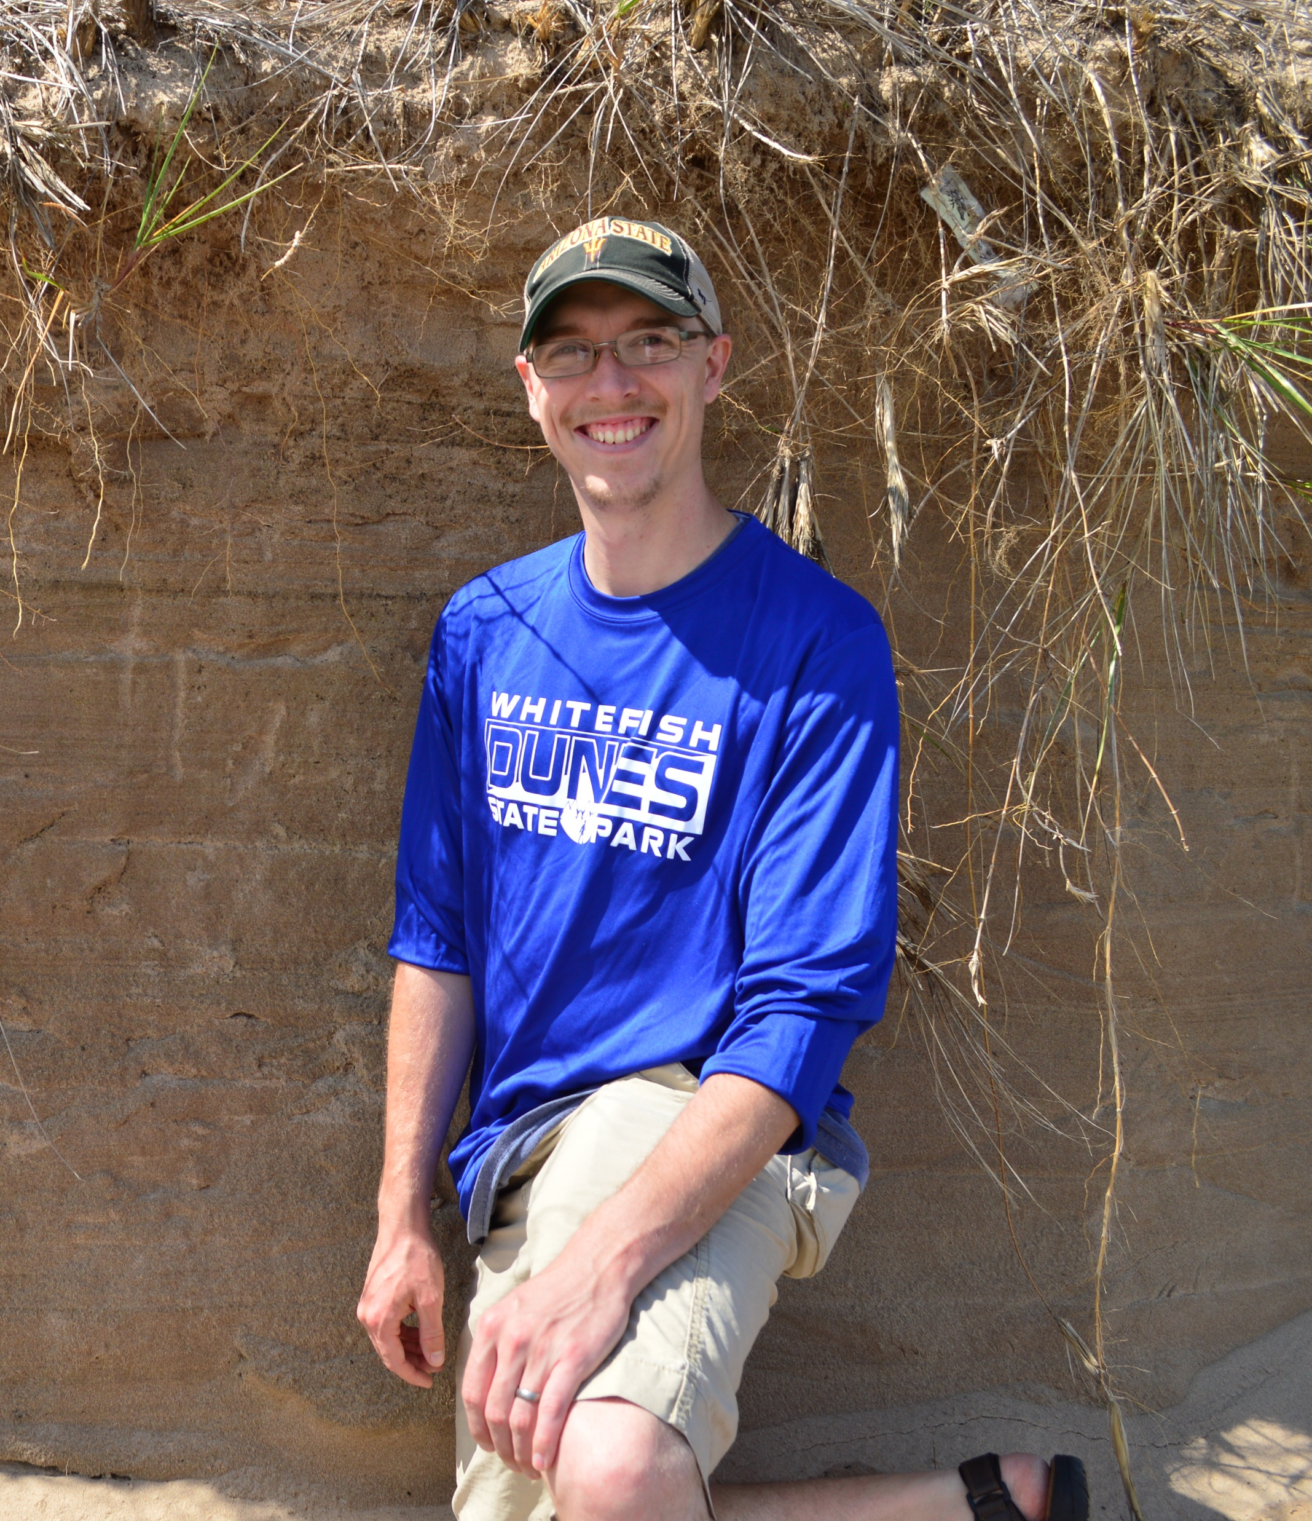
Objectives
Understand Different Ratios
Understand How Those Ratios Are Used
The geo-nerd currently talking…

Slide 3
Background: Ratios
Ratio: Comparison of two values as a quotient

Slide 4

Background: Ratios
Ratio: Comparison of two values as a quotient
8 Apples

Slide 5

Background: Ratios
Ratio: Comparison of two values as a quotient
8 Apples
4 Bananas

Slide 6

Background: Ratios
Ratio: Comparison of two values as a quotient
8 Apples
4 Bananas
Great Smoothie

Slide 7
Background: Ratios
Ratio: Comparison of two values as a quotient
8 Apples
4 Bananas
Great Smoothie
8:4 Ratio (2:1 Simplified)
8:4
(2:1)

Slide 8

Background: Ratios
Ratio: Comparison of two values as a quotient
8 Apples
4 Bananas
Great Smoothie
8:4 Ratio (2:1 Simplified)
Wind Ripples

Slide 9
Background: Ratios
Ratio: Comparison of two values as a quotient
8 Apples
4 Bananas
Great Smoothie
8:4 Ratio (2:1 Simplified)
Wind Ripples
Length

Slide 10
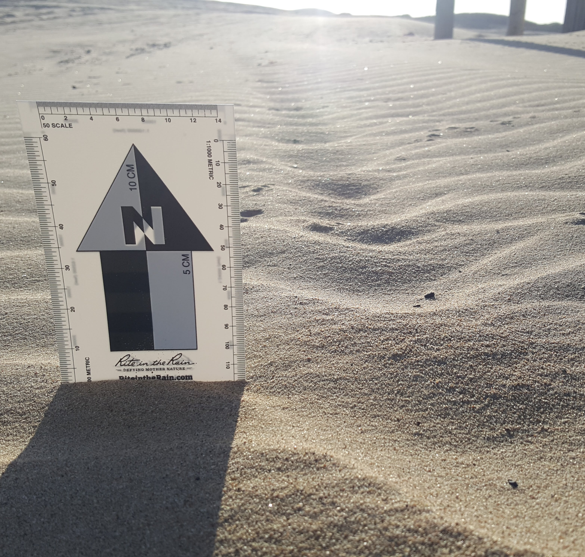
Background: Ratios
Ratio: Comparison of two values as a quotient
8 Apples
4 Bananas
Great Smoothie
8:4 Ratio (2:1 Simplified)
Wind Ripples
Height

Slide 11
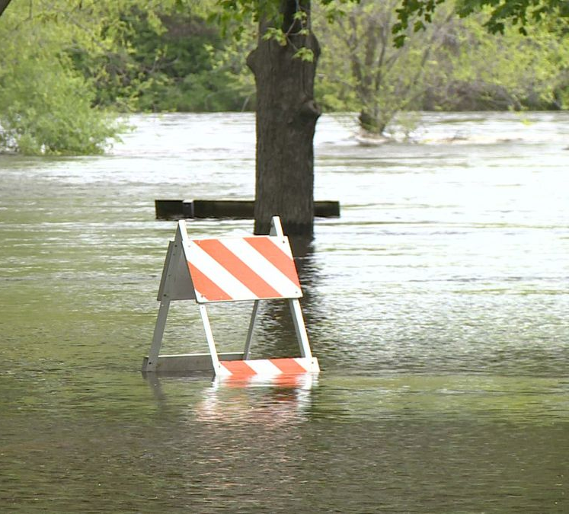
Background: Bankfull Stage
Initial Point of Flooding
Chippewa River, Wisconsin, USA
https://www.weau.com/content/news/Chippewa-River-above-flood-stage-510226901.html

Slide 12
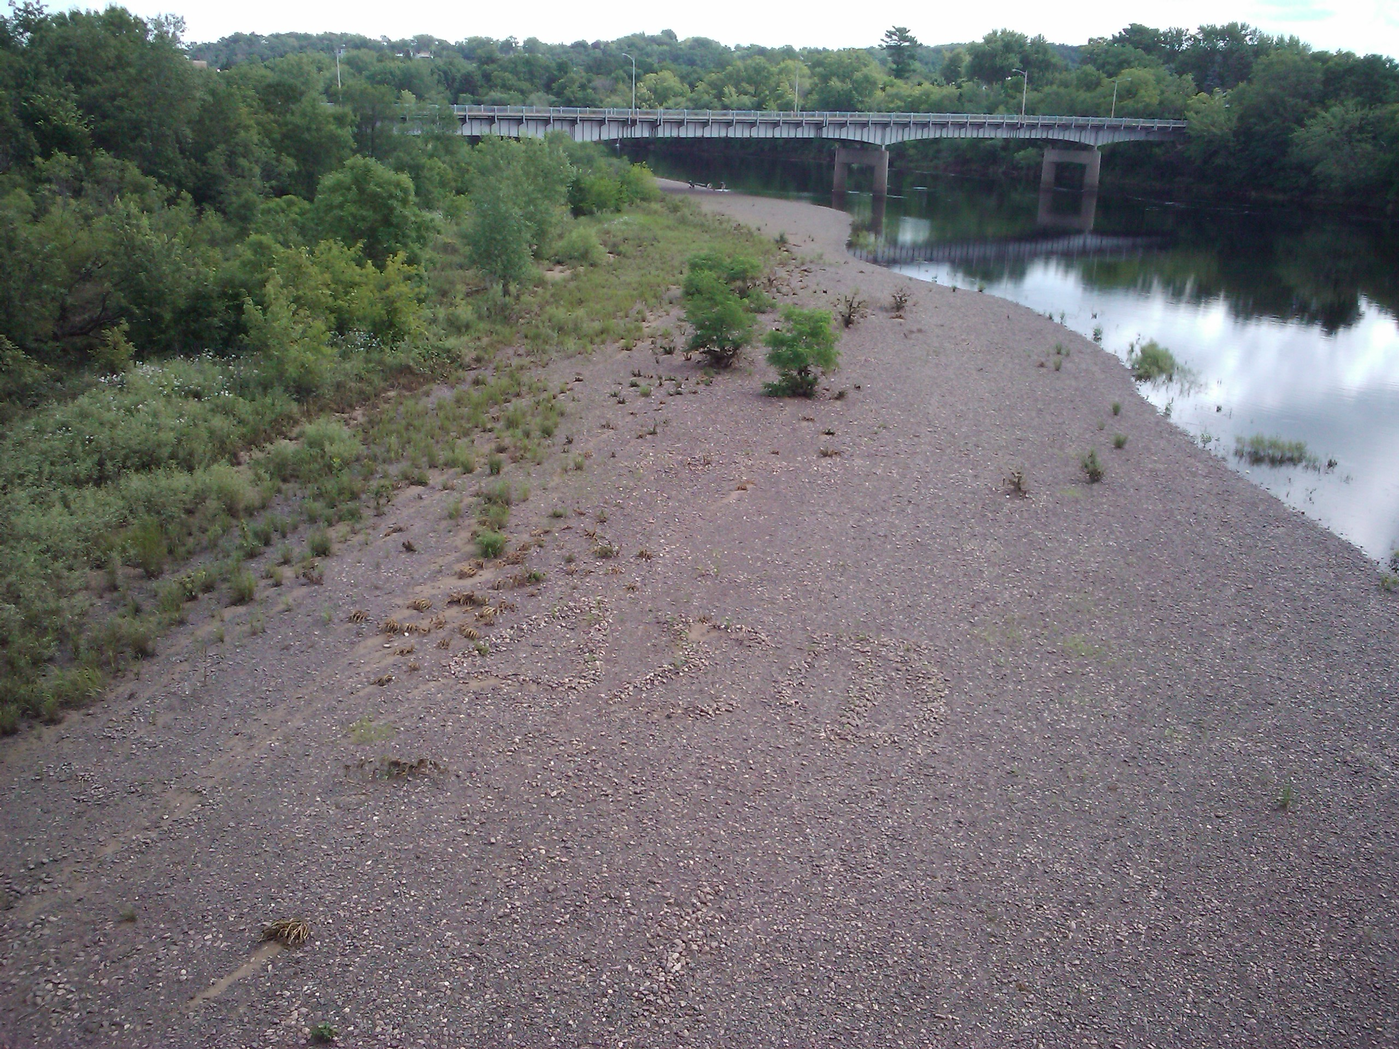
Background: Bankfull Stage
Initial Point of Flooding
Chippewa River, Wisconsin, USA
Photo Credit. Dr. Doug Faulkner

Slide 13
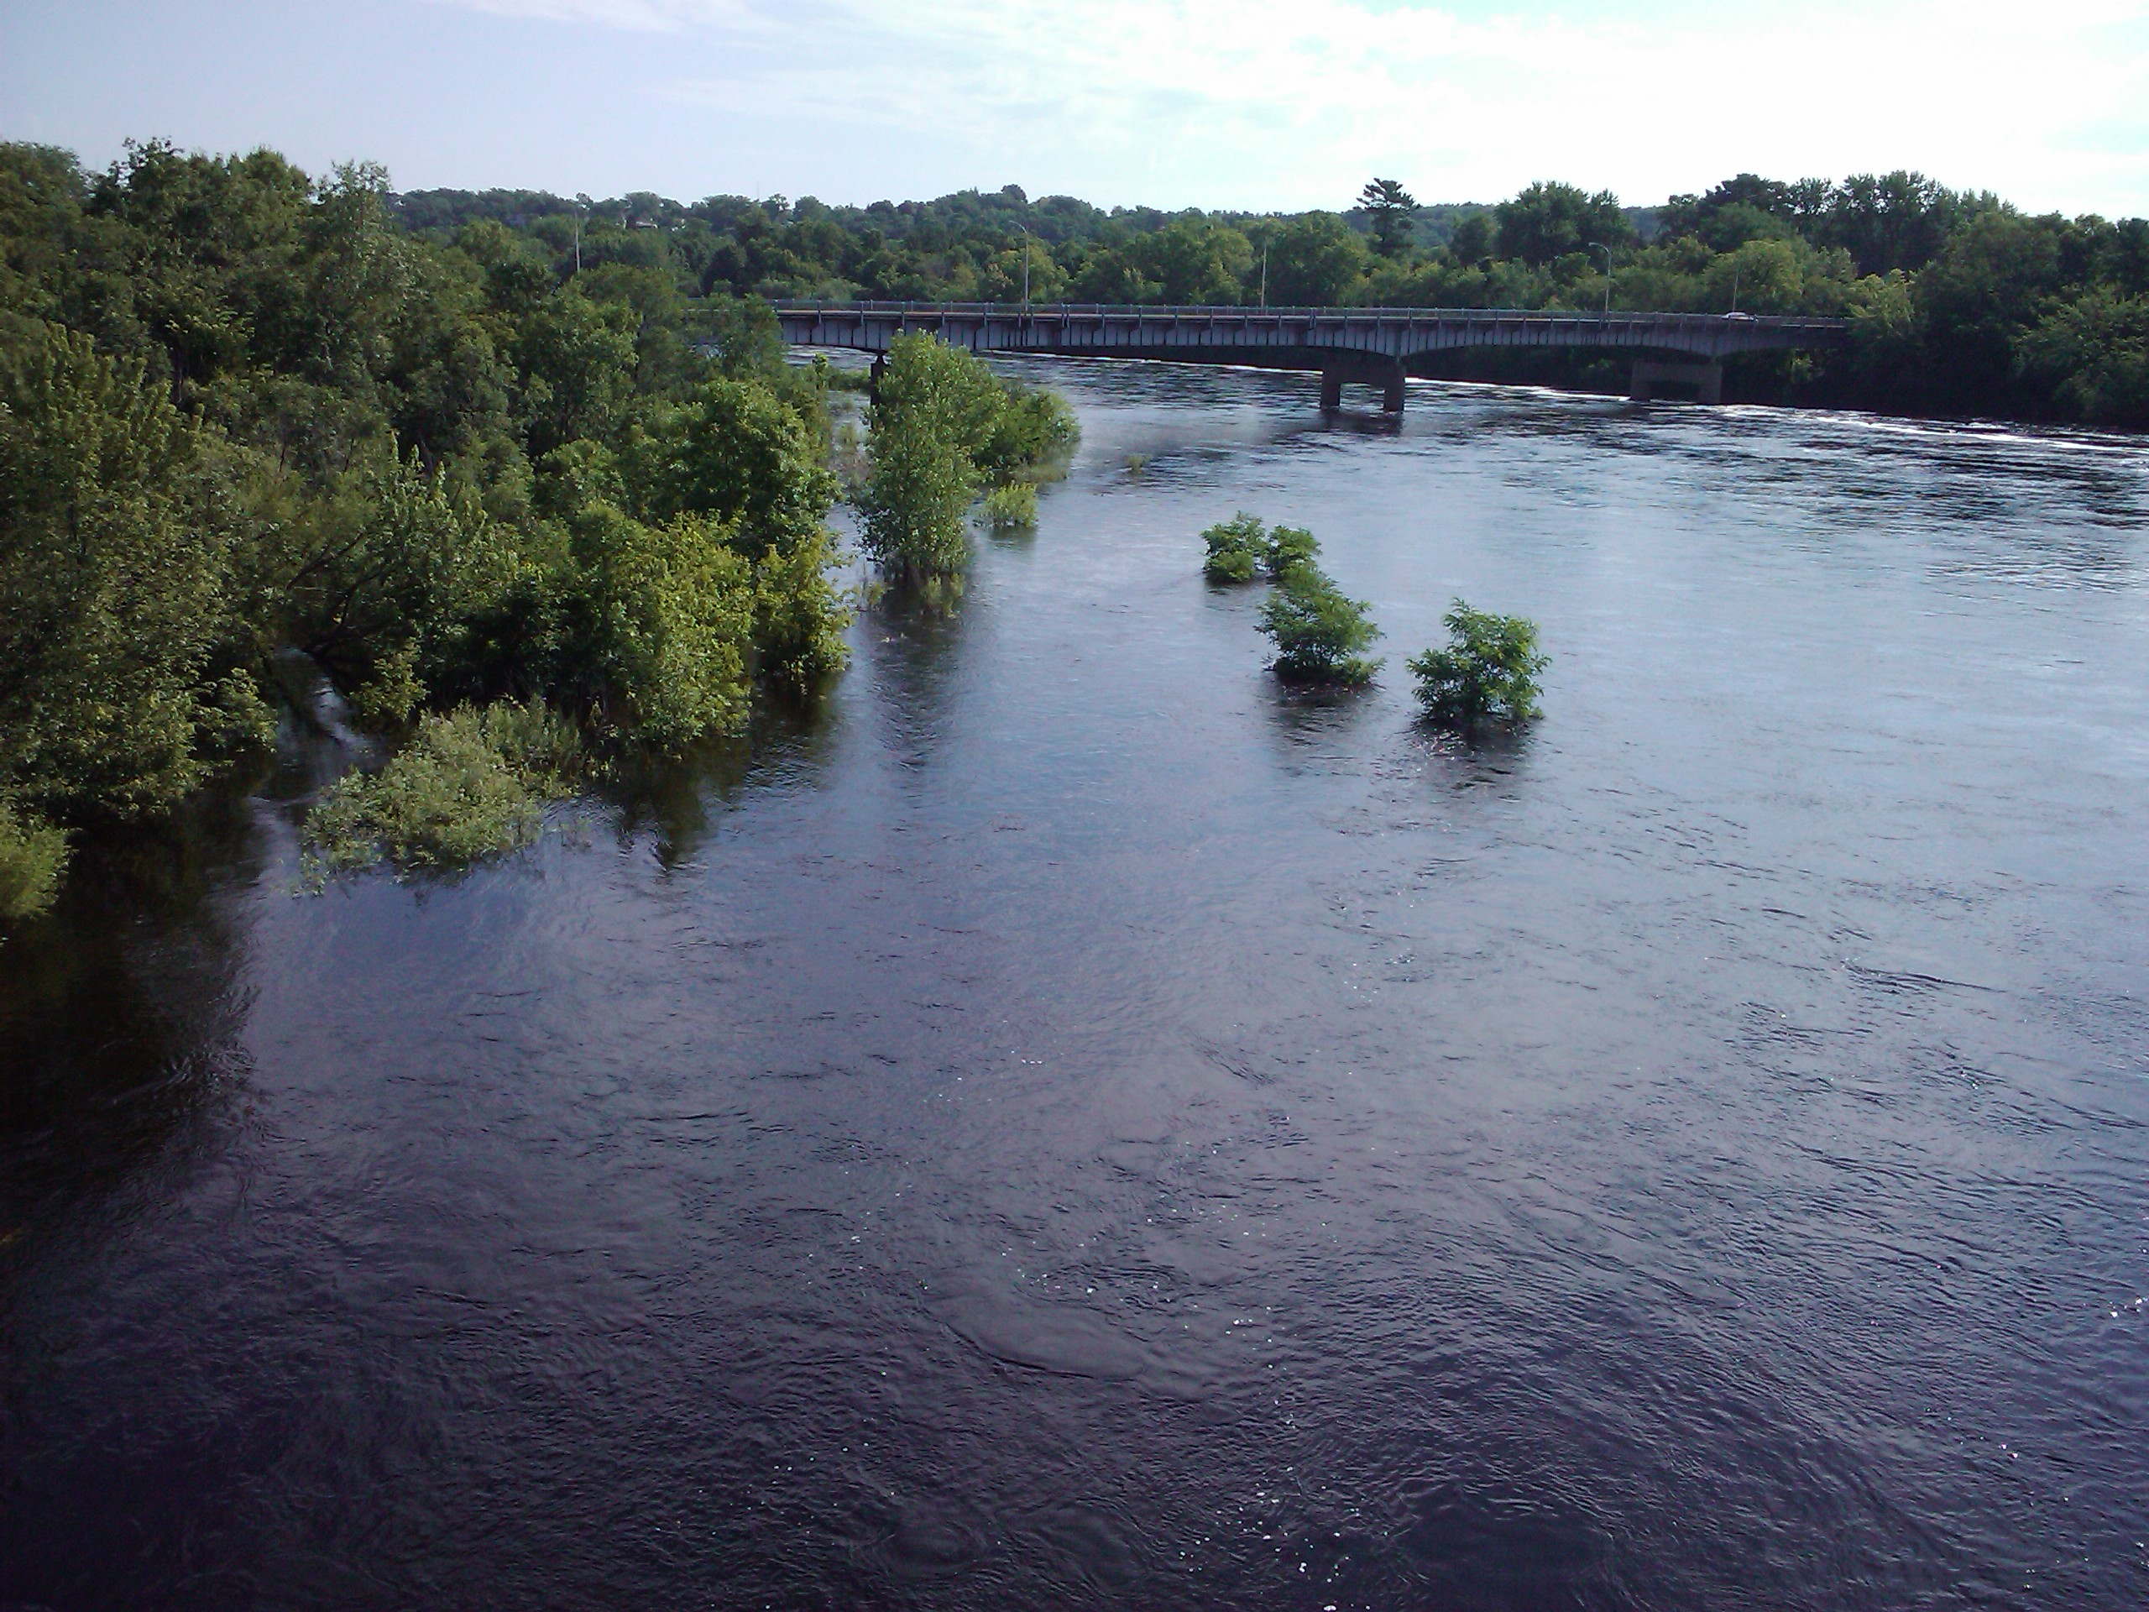
Background: Bankfull Stage
Initial Point of Flooding
Chippewa River, Wisconsin, USA
Photo Credit. Dr. Doug Faulkner

Slide 14
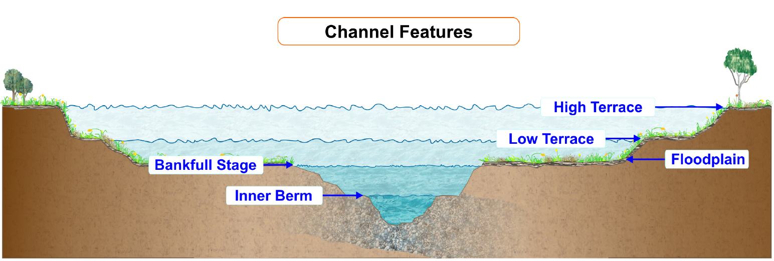
Background: Bankfull Stage
Initial Point of Flooding
~1.5 Year Recurrence
Wildlands Hydrology: Cross Section handout

Slide 15
Background: Bankfull Stage
Initial Point of Flooding
~1.5 Year Recurrence
Important for Classification

Slide 16
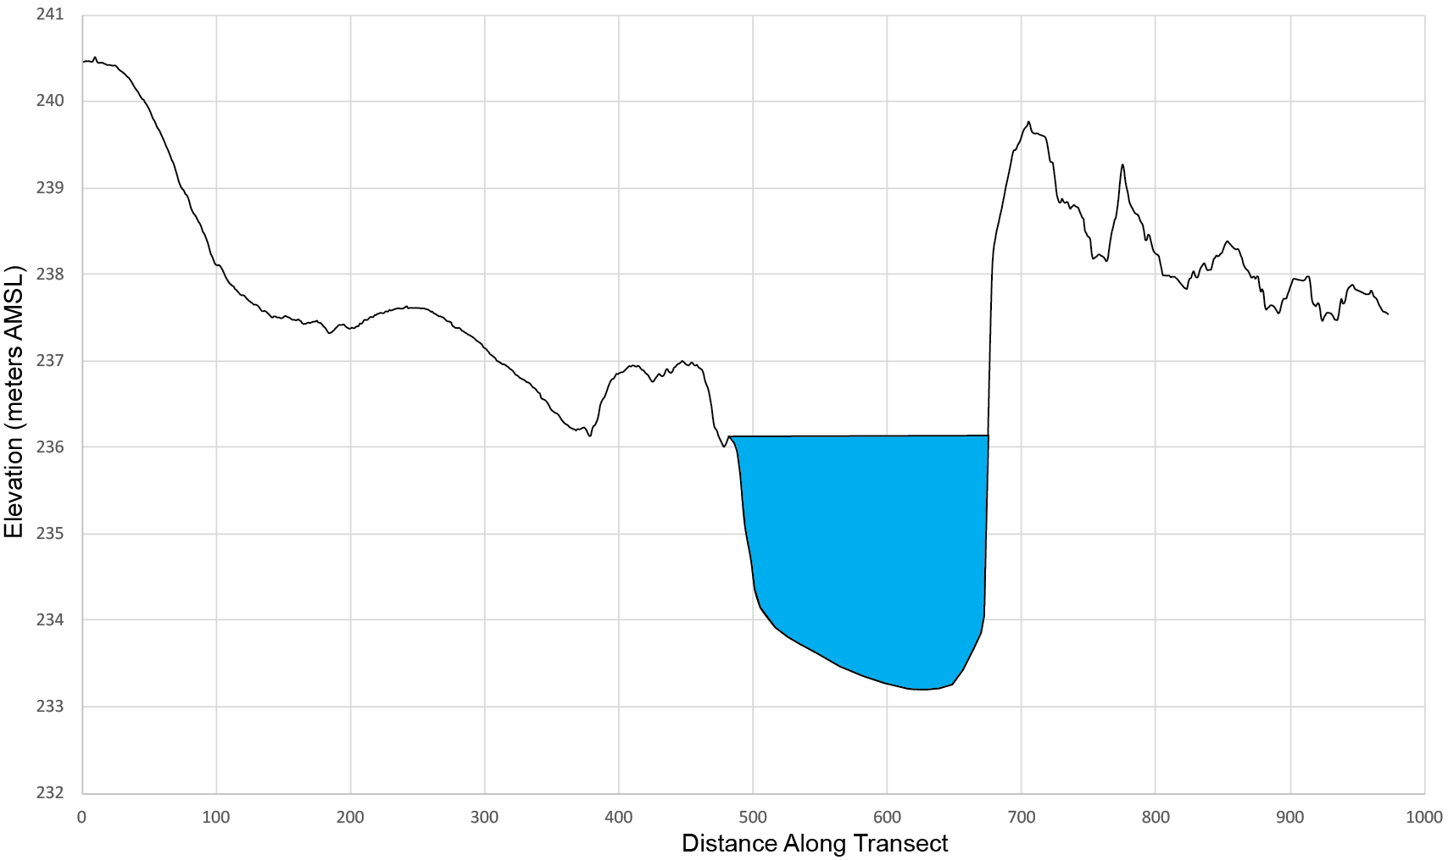
Background: Bankfull Stage
Initial Point of Flooding
~1.5 Year Recurrence
Important for Classification
2D Example
Flow Below Bankfull

Slide 17
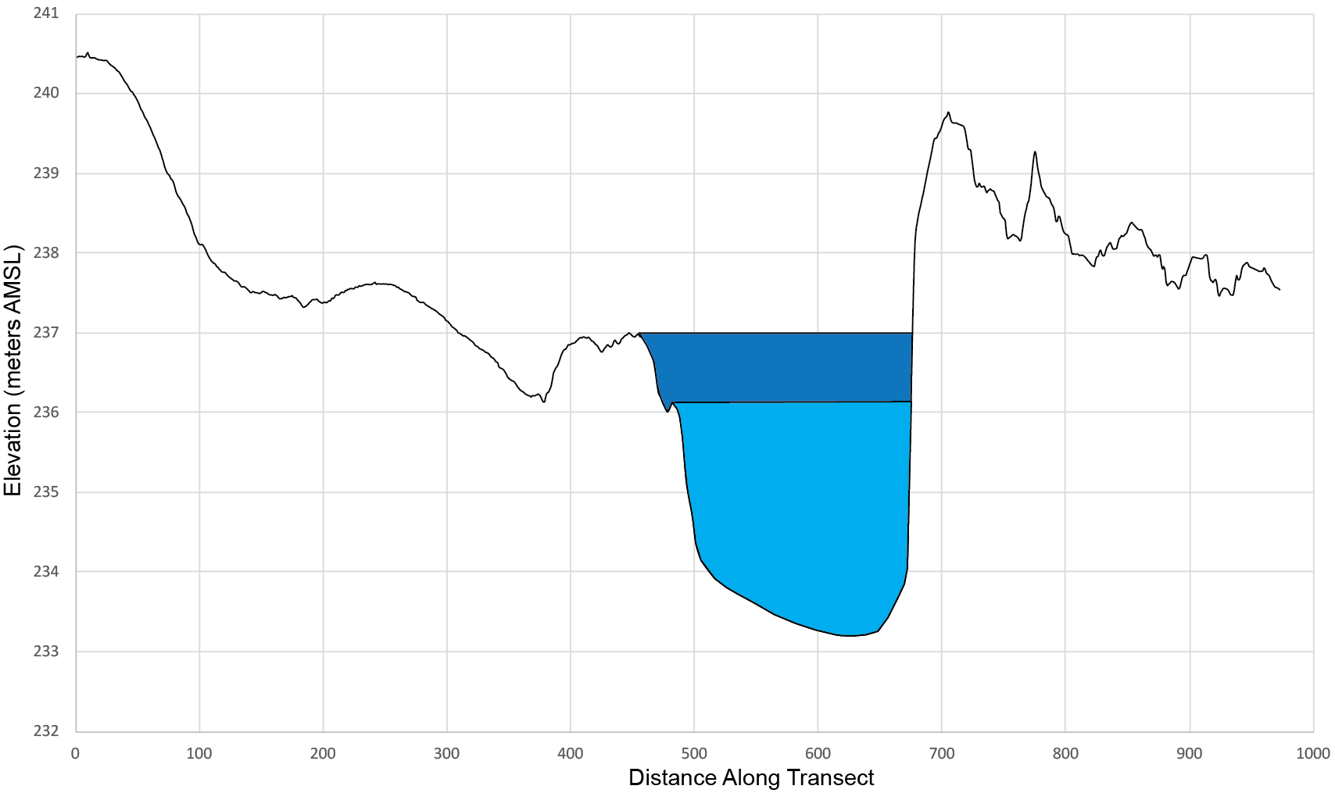
Background: Bankfull Stage
Initial Point of Flooding
~1.5 Year Recurrence
Important for Classification
2D Example
Bankfull

Slide 18
Background: Bankfull Stage
Initial Point of Flooding
~1.5 Year Recurrence
Important for Classification
2D Example
Bankfull

Slide 19
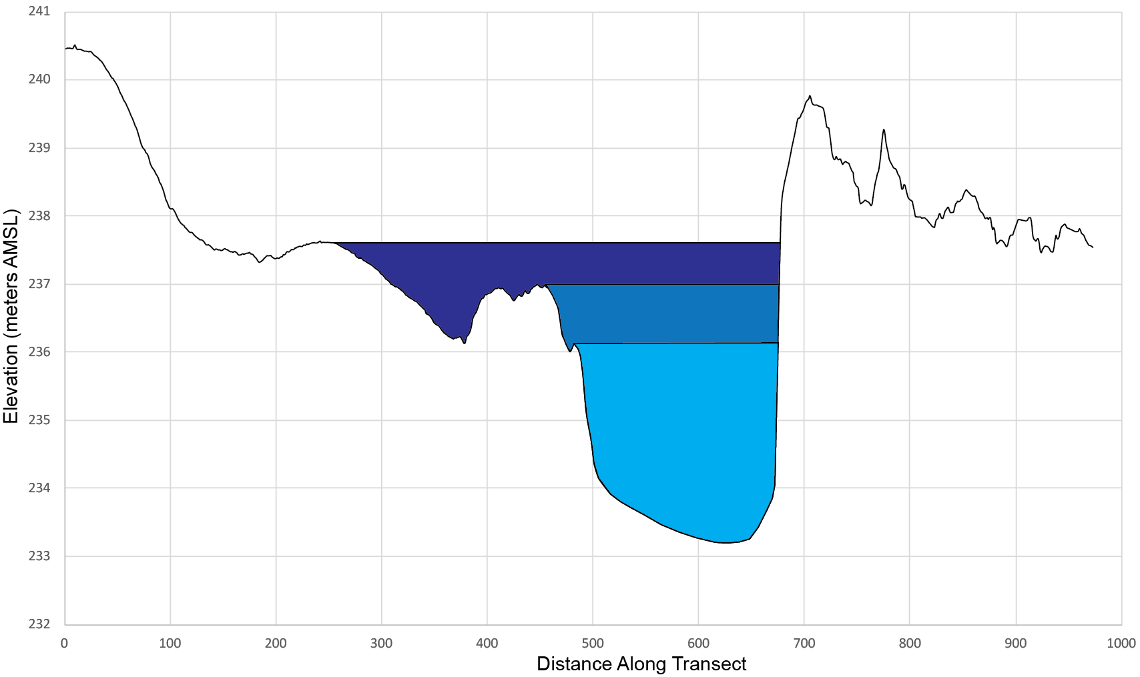
Background: Bankfull Stage
Initial Point of Flooding
~1.5 Year Recurrence
Important for Classification
2D Example
Flooding

Slide 20
Width:Depth Ratio
Describes the Shape of the Channel
Bankfull

Slide 21
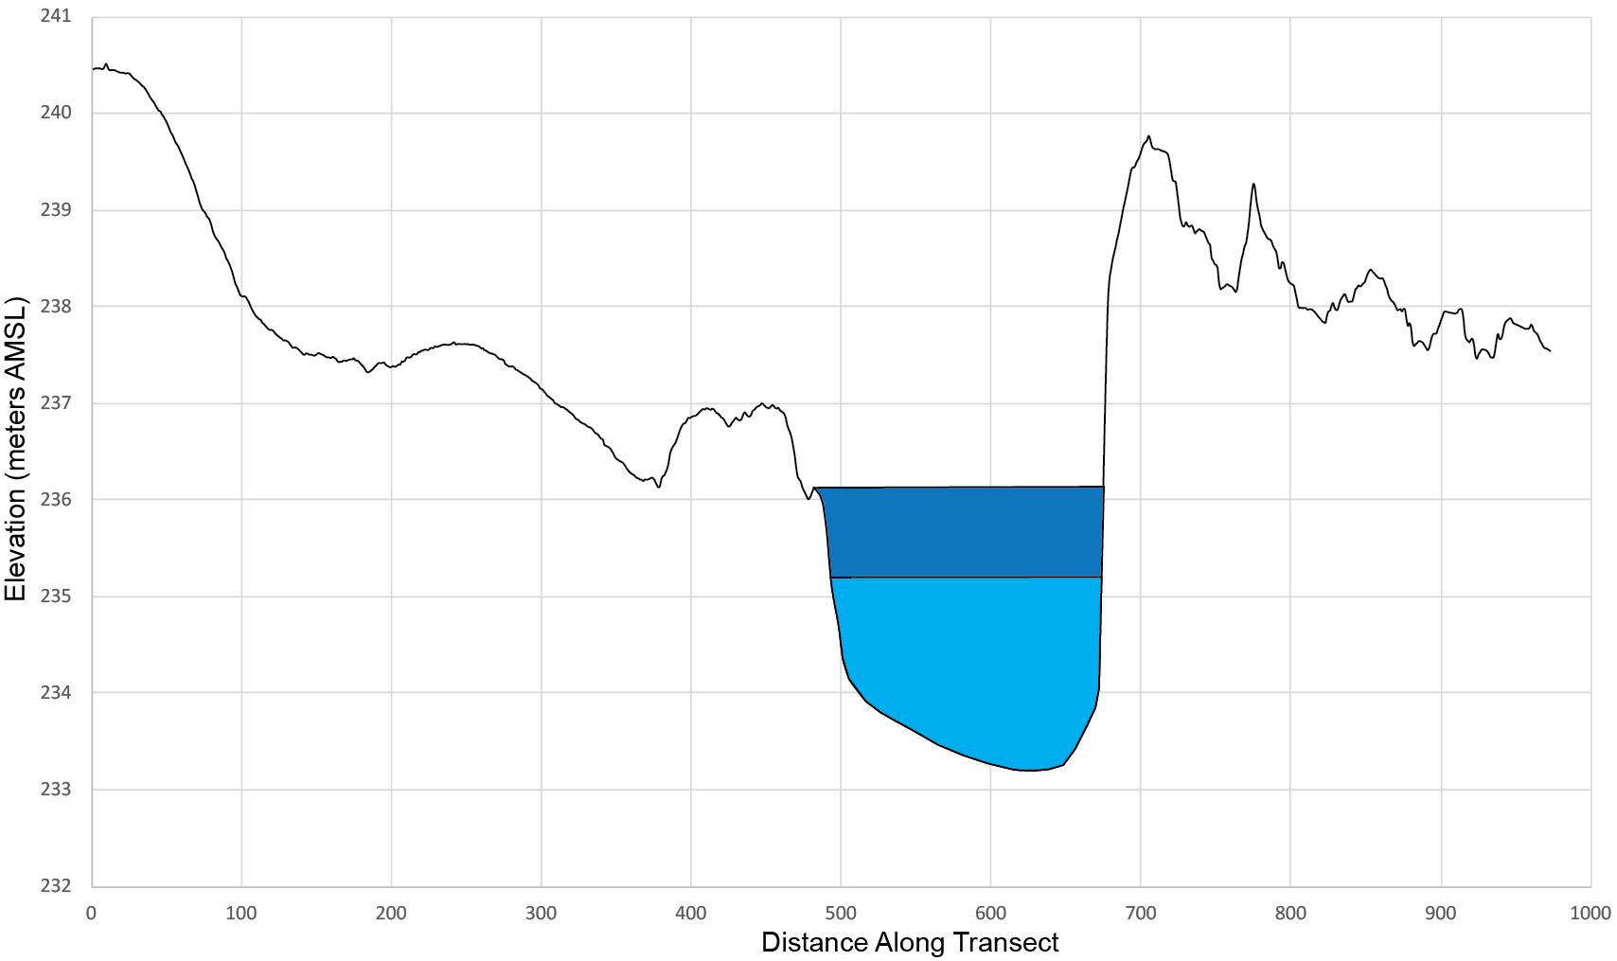
Width:Depth Ratio
Describes the Shape of the Channel
Bankfull
Bankfull

Slide 22
Width:Depth Ratio
Describes the Shape of the Channel
Width of the Bankfull Surface
Bankfull
Width
Bankfull
Width

Slide 23
Width:Depth Ratio
Describes the Shape of the Channel
Width of the Bankfull Surface
Mean Depth of the Bankfull Channel
Average
Bankfull
Depth

Slide 24

Width:Depth Ratio
Describes the Shape of the Channel
Width of the Bankfull Surface
Mean Depth of the Bankfull Channel
Large Number: Shallow + Wide

Slide 25

Width:Depth Ratio
Describes the Shape of the Channel
Width of the Bankfull Surface
Mean Depth of the Bankfull Channel
Large Number: Shallow + Wide
Small Number: Narrow + Deep

Slide 26
Longitudinal Profile
Slope
Boulders
0.02
0.001
0.00001
Modified from Anderson and Anderson (2010)
Width:
Depth Ratio
Lowest
Highest

Slide 27
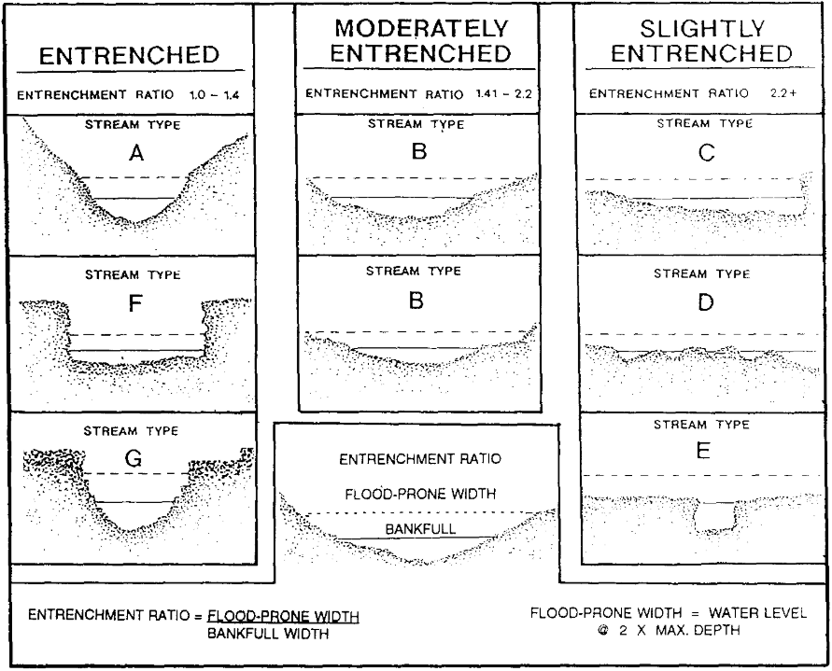
Entrenchment Ratio
Defined by Rosgen (1994)
Figure 6, Rosgen (1994)

Slide 28
Entrenchment Ratio
Defined by Rosgen (1994)
Vertical Containment of the River
Figure 6, Rosgen (1994)

Slide 29
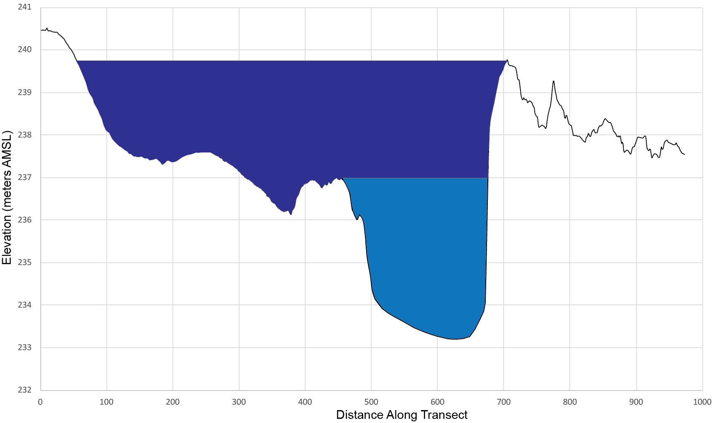
Entrenchment Ratio
Defined by Rosgen (1994)
Vertical Containment of the River
Width of Flood-Prone Area
Bankfull
Depth x2
Width of Flood-Prone Area
Bankfull
Depth

Slide 30
Entrenchment Ratio
Defined by Rosgen (1994)
Vertical Containment of the River
Width of Flood-Prone Area
Width of Bankfull Channel
Bankfull
Width

Slide 31
Entrenchment Ratio
Defined by Rosgen (1994)
Vertical Containment of the River
Width of Flood-Prone Area
Width of Bankfull Channel
Figure 6, Rosgen (1994)

Slide 32
Entrenchment Ratio
Defined by Rosgen (1994)
Vertical Containment of the River
Width of Flood-Prone Area
Width of Bankfull Channel
Figure 6, Rosgen (1994)

Slide 33
Entrenchment Ratio
Defined by Rosgen (1994)
Vertical Containment of the River
Width of Flood-Prone Area
Width of Bankfull Channel
Figure 6, Rosgen (1994)

Slide 34
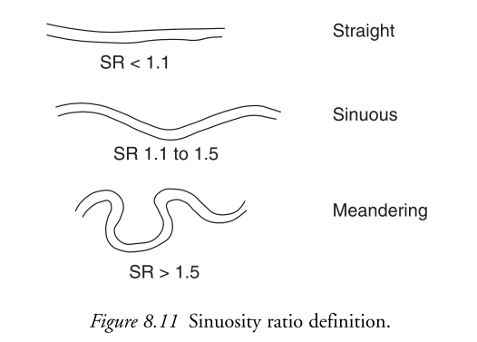
Other Ratios
Sinuosity
Length of Channel / Length of Valley Center
Charlton (2008): Fundamentals of Fluvial Geomorphology

Slide 35
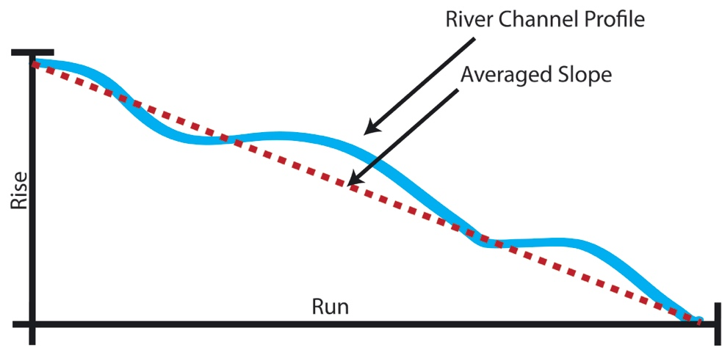
Other Ratios
Sinuosity
Length of Channel / Length of Valley Center
Slope
Change in Elevation / Change in Distance

Slide 36
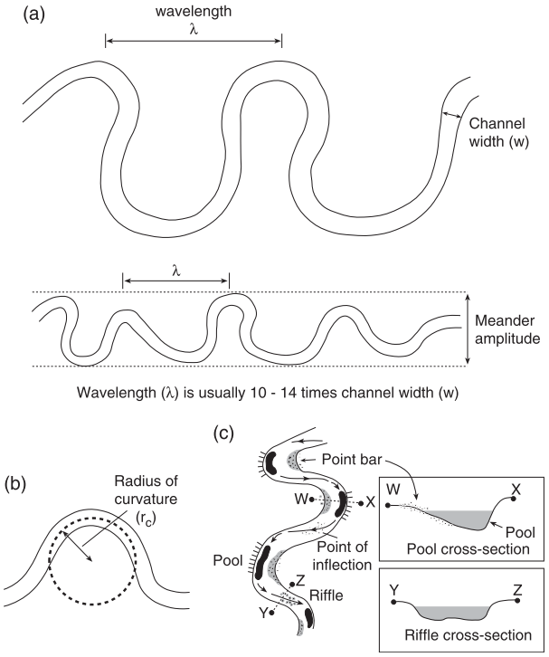
Other Ratios
Sinuosity
Length of Channel / Length of Valley Center
Slope
Change in Elevation / Change in Distance
Meander Wavelength
Meander Bend Wavelength
Channel Width
Charlton (2008): Fundamentals of Fluvial Geomorphology

Slide 37
Other Ratios
Sinuosity
Length of Channel / Length of Valley Center
Slope
Change in Elevation / Change in Distance
Meander Wavelength
Meander Bend Wavelength
Channel Width
Radius of Curvature
Radius of the meander bend
Channel Width
Charlton (2008): Fundamentals of Fluvial Geomorphology

Slide 38
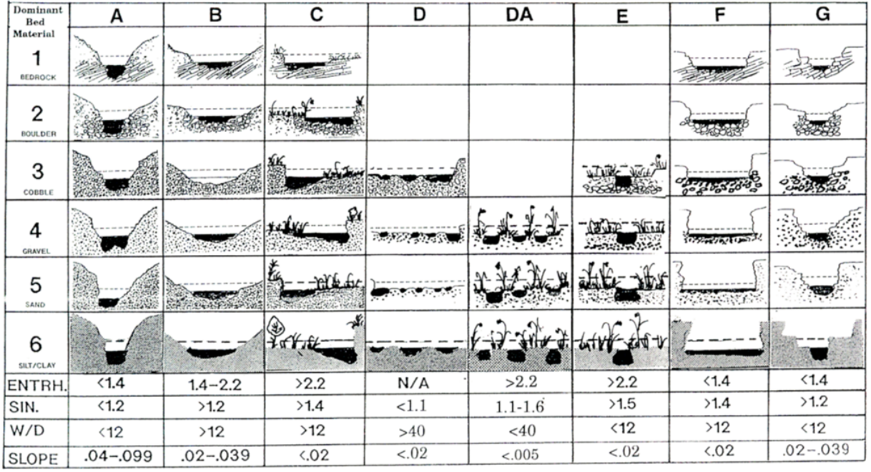
Ratios and classifications
Entrenchment
Sinuosity
Width:Depth
Slope
Figure 4, Rosgen (1994)

Slide 39
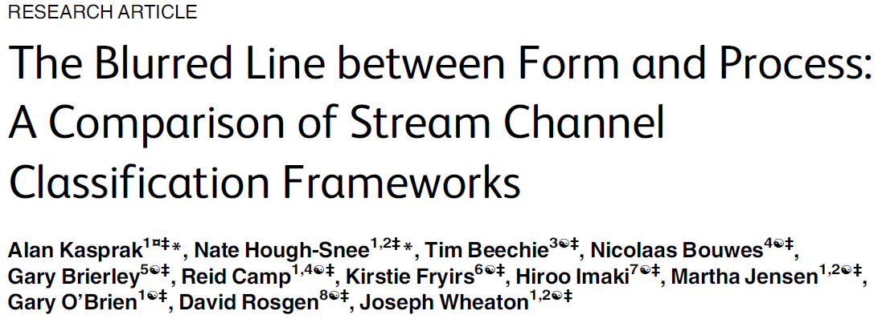
Recap

Slide 40
Recap
Definitions
Ratios
How to Use Ratios
Figure 4, Rosgen (1994)

